Slide 1
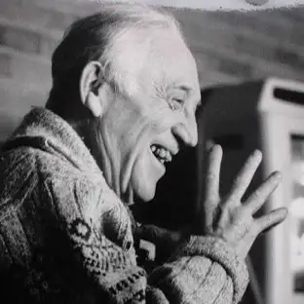




Morrie Schwartz
How do we value a dying man?
Morrie Schwartz was diagnosed with ALS and died in November of 1995.
He was the main subject of best-selling author, Mitch Albom’s, memoir titled Tuesdays with Morrie.
Why we should allow dying people to die.
November 2024
Legal in 10 states and D.C.
"This culture is so stuck on death, in terms of its fear, hiding it, not knowing what to do with it, that what I'm saying is, is there an alternative way of looking at it?"
-Morrie Schwartz
Considered in Michigan and New York this year.
March 2022
Oscar Yang

